Slide 1
Bandwidth Utilization: Multiplexing and Spreading
6.1

Slide 2

Note
Bandwidth utilization is the wise use of available bandwidth to achieve specific goals.
Efficiency can be achieved by multiplexing; privacy and anti-jamming can be achieved by spreading.
6.2

Slide 3
6-1 MULTIPLEXING
Whenever the bandwidth of a medium linking two devices is greater than the bandwidth needs of the devices, the link can be shared. Multiplexing is the set of techniques that allows the simultaneous transmission of multiple signals across a single data link.. As data and telecommunications use increases, so does traffic.
Topics discussed in this section: Frequency-Division Multiplexing Wavelength-Division Multiplexing Synchronous Time-Division Multiplexing Statistical Time-Division Multiplexing
6.3

Slide 4
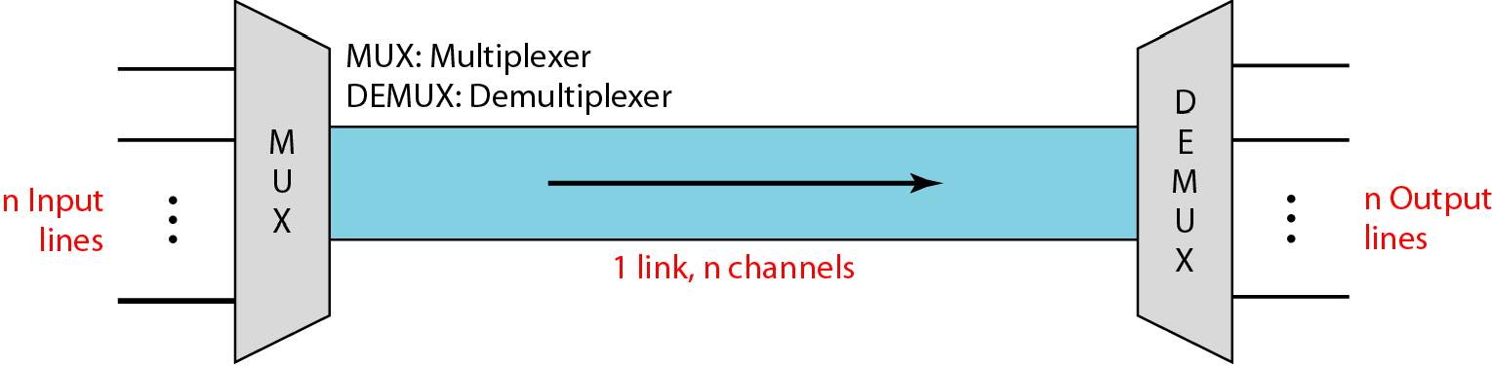
Figure 6.1 Dividing a link into channels
6.4

Slide 5
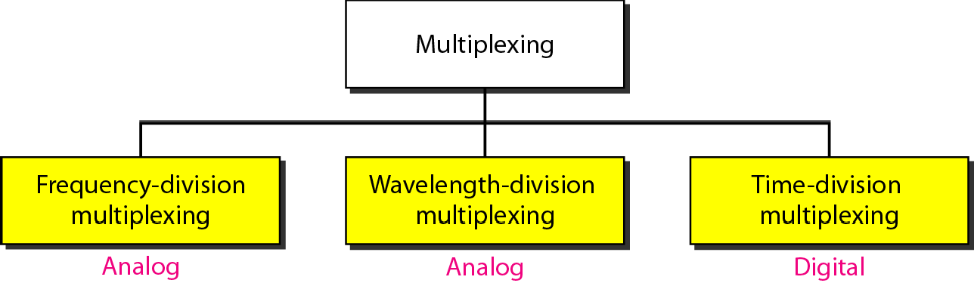
Figure 6.2 Categories of multiplexing
6.5

Slide 6
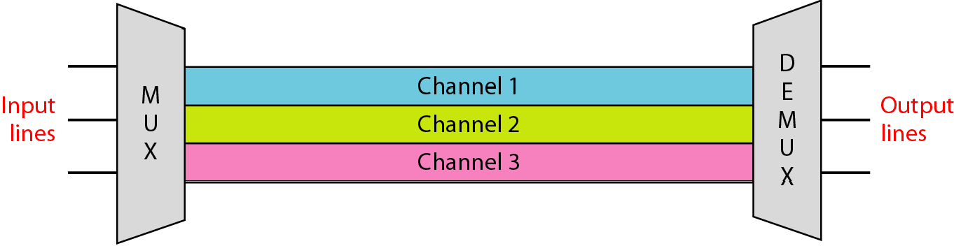
Figure 6.3 Frequency-division multiplexing
6.6

Slide 7
Note
FDM is an analog multiplexing technique that combines analog signals.
6.7

Slide 8
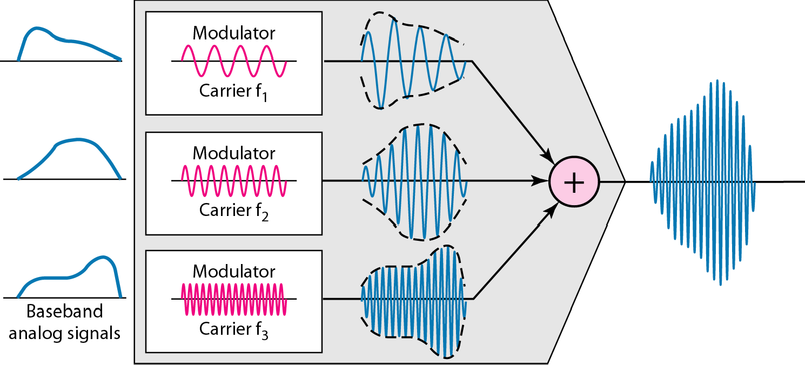
Figure 6.4 FDM process
6.8

Slide 9
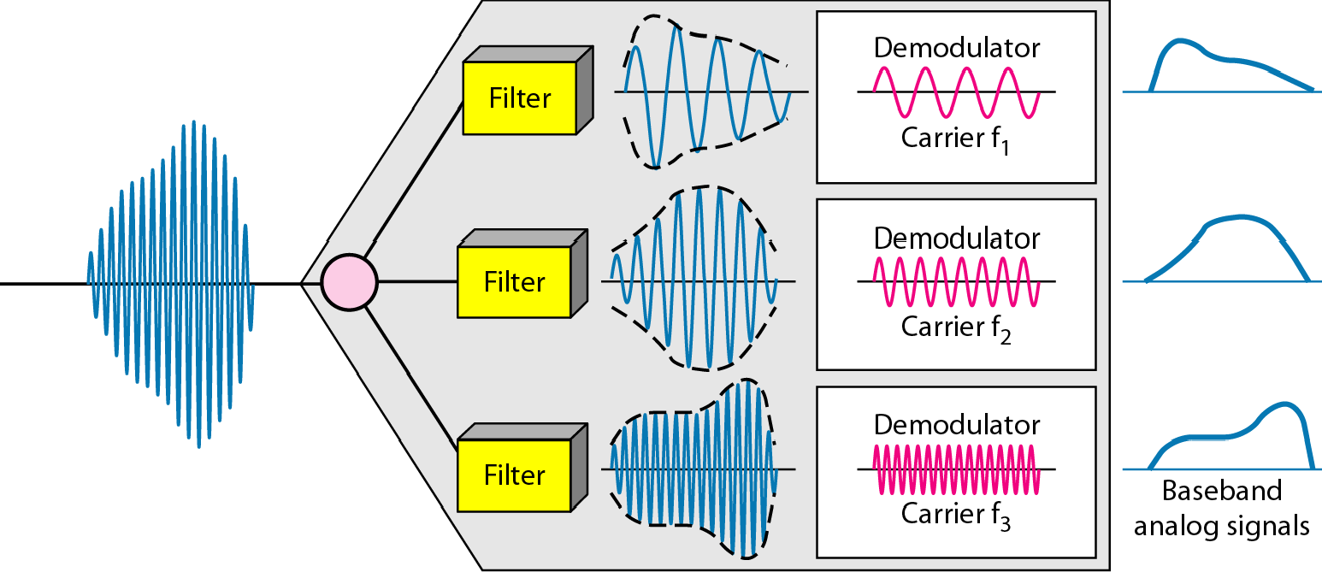
Figure 6.5 FDM demultiplexing example
6.9

Slide 10
Example 6.1
Assume that a voice channel occupies a bandwidth of 4 kHz. We need to combine three voice channels into a link with a bandwidth of 12 kHz, from 20 to 32 kHz. Show the configuration, using the frequency domain. Assume there are no guard bands.
Solution
We shift (modulate) each of the three voice channels to a different bandwidth, as shown in Figure 6.6. We use the 20- to 24-kHz bandwidth for the first channel, the 24- to 28-kHz bandwidth for the second channel, and the 28- to 32-kHz bandwidth for the third one. Then we combine them as shown in Figure 6.6.

Slide 11
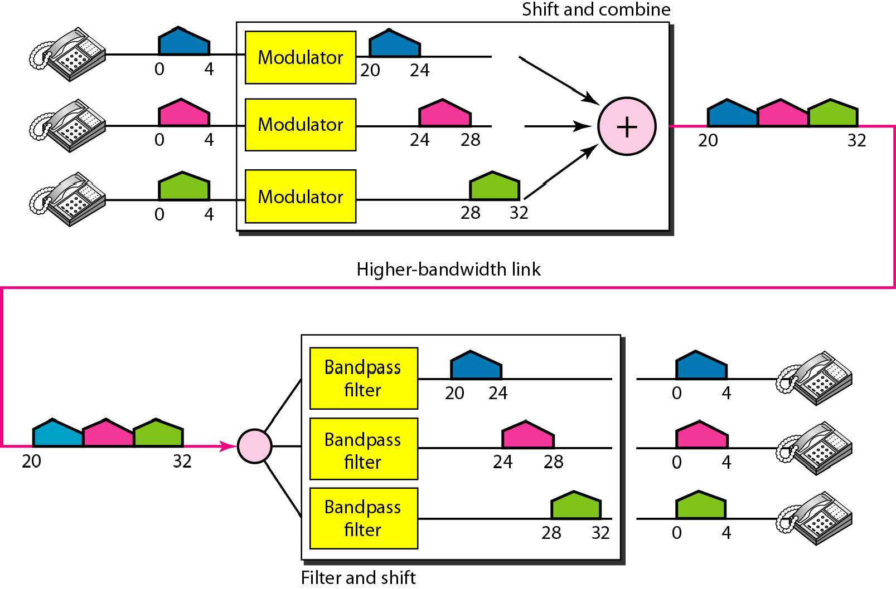
Figure 6.6 Example 6.1

Slide 12
Example 6.2
Five channels, each with a 100-kHz bandwidth, are to be multiplexed together. What is the minimum bandwidth of th link if ther is a need for a guard band of 10 kHz between the channels to prevent interference?
Solution
For five channels, we need at least four guard bands. This means that the required bandwidth is at least
5 × 100 + 4 × 10 = 540 kHz,
as shown in Figure 6.7.

Slide 13
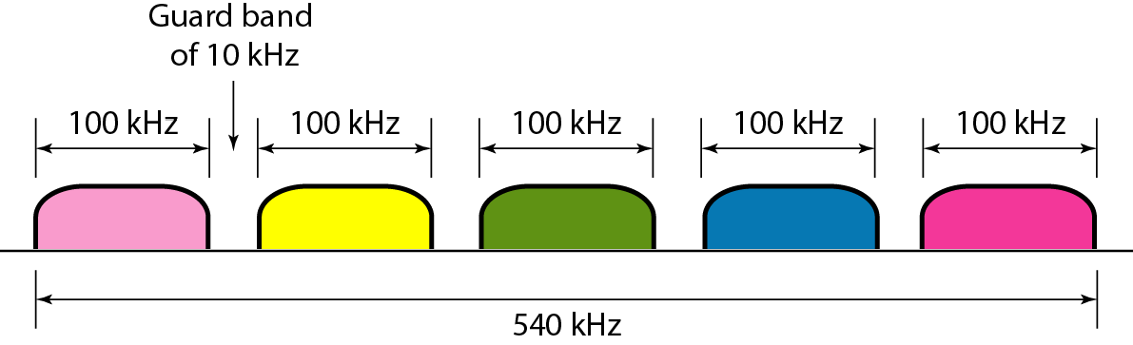
Figure 6.7 Example 6.2

Slide 14
Example 6.3
Four data channels (digital), each transmitting at 1 Mbps, use a satellite channel of 1 MHz. Design an appropriate configuration, using FDM
Solution
The satellite channel is analog. We divide it into four channels, each channel having a 250-kHz bandwidth. Each digital channel of 1 Mbps is modulated such that each 4 bits is modulated to 1 Hz. One solution is 16-QAM modulation. Figure 6.8 shows one possible configuration.

Slide 15
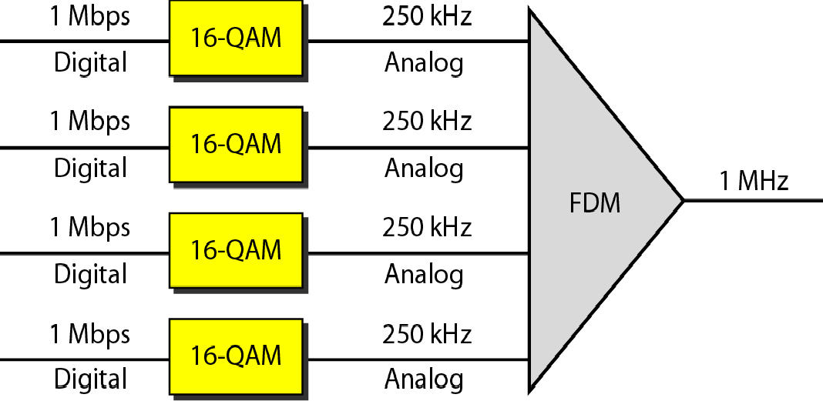
Figure 6.8 Example 6.3

Slide 16
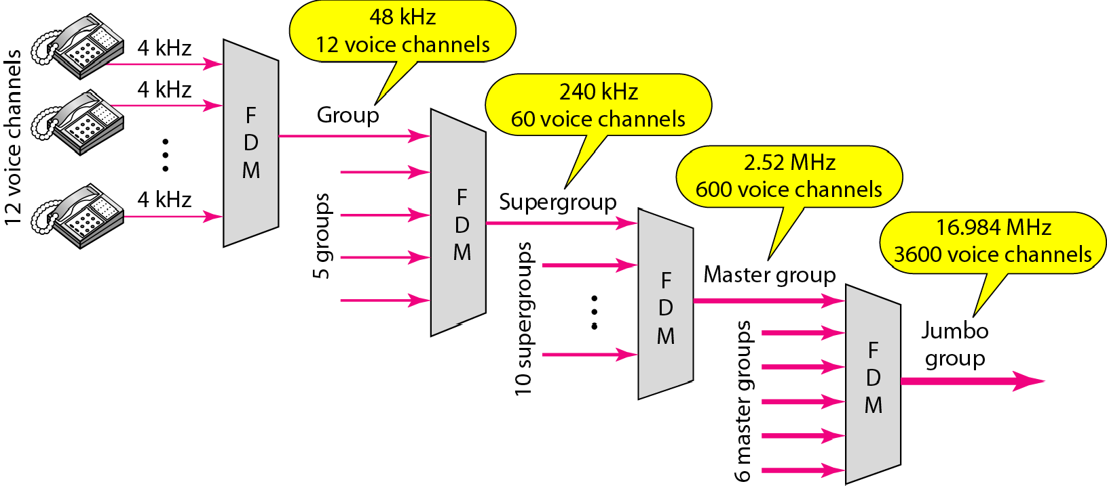
Figure 6.9 Analog hierarchy

Slide 17
Example 6.4
The Advanced Mobile Phone System (AMPS) uses two bands The first band of 824 to 849 MHz is used for sending, and 869 to 894 MHz is used for receiving. Each user has a bandwidth of 30 kHz in each direction
How many people can use their cellular phones
simultaneously? Solution
Each band is 25 MHz. If we divide 25 MHz by 30 kHz, we
get 833.33. In reality, the band is divided into 832 channels. Of these, 42 channels are used for control, which means only 790 channels are available for cellular phone users.

Slide 18
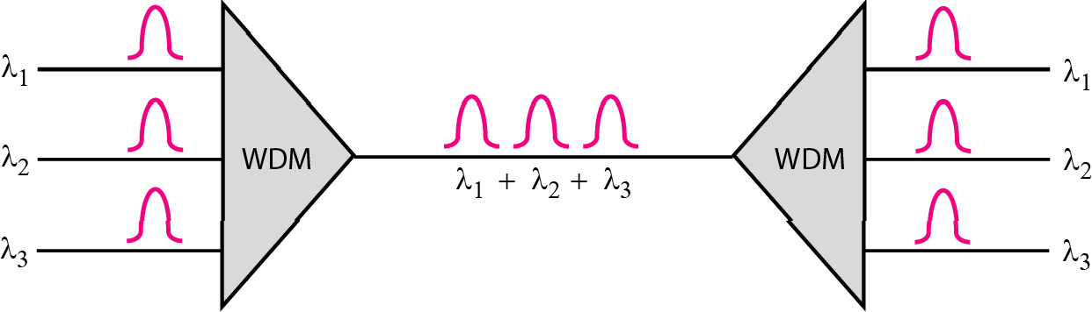
Figure 6.10 Wavelength-division multiplexing

Slide 19
Note
WDM is an analog multiplexing technique to combine optical signals.

Slide 20
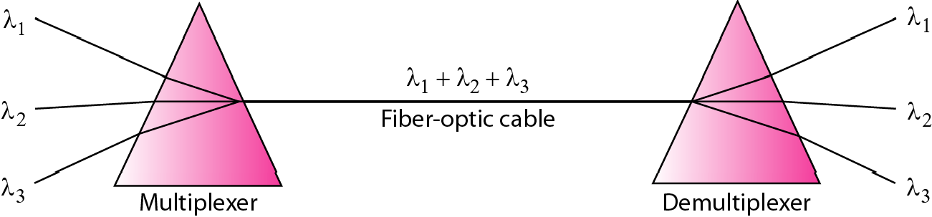
Figure 6.11 Prisms in wavelength-division multiplexing and demultiplexing

Slide 21
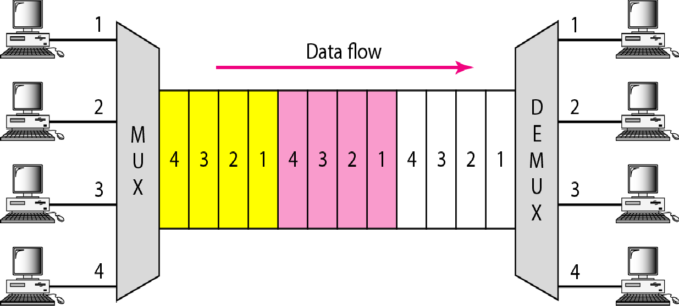
Figure 6.12 TDM

Slide 22

Note
for combining several low-rate channels into one high-rate one.
TDM is a digital multiplexing technique

Slide 23
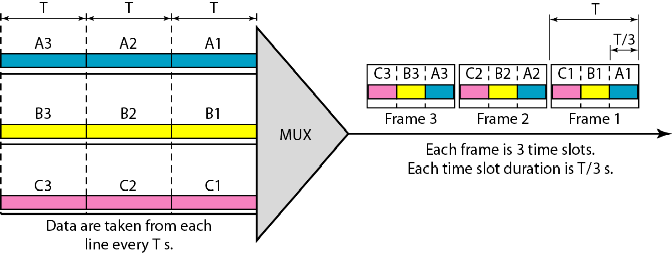
Figure 6.13 Synchronous time-division multiplexing

Slide 24

Note
In synchronous TDM, the data rate of the link is n times faster, and the unit
duration is n times shorter.

Slide 25
Example 6.5
In Figure 6.13, the data rate for each input connection is 3 kbps. If 1 bit at a time is multiplexed (a unit is 1 bit), what is the duration of (a) each input slot, (b) each output slot, and (c) each frame?
Solution
We can answer the questions as follows:
a. The data rate of each input connection is 1 kbps. This means that the bit duration is 1/1000 s or 1 ms. The duration of the input time slot is 1 ms (same as bit duration).

Slide 26
Example 6.5 (continued)
b. The duration of each output time slot is one-third of the input time slot. This means that the duration of the output time slot is 1/3 ms.
c. Each frame carries three output time slots. So the duration of a frame is 3 × 1/3 ms, or 1 ms. The duration of a frame is the same as the duration of an input unit.

Slide 27
Example 6.6
Figure 6.14 shows synchronous TDM with a data stream for each input and one data stream for the output. The unit of data is 1 bit. Find (a) the input bit duration, (b) the output bit duration, (c) the output bit rate, and (d) the output frame rate.
Solution
We can answer the questions as follows:
The input bit duration is the inverse of the bit rate: 1/1 Mbps = 1 μs.
The output bit duration is one-fourth of the input bit duration, or ¼ μs.

Slide 28
Example 6.6 (continued)
c. The output bit rate is the inverse of the output bit duration or 1/(4μs) or 4 Mbps. This can also be deduced from the fact that the output rate is 4 times as fast as any input rate; so the output rate = 4 × 1 Mbps
= 4 Mbps.
d. The frame rate is always the same as any input rate. So the frame rate is 1,000,000 frames per second. Because we are sending 4 bits in each frame, we can verify the result of the previous question by multiplying the frame rate by the number of bits per frame.

Slide 29
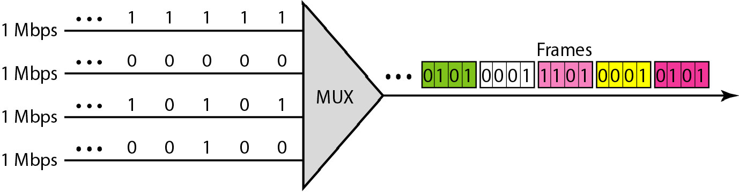
Figure 6.14 Example 6.6

Slide 30
Example 6.7
Four 1-kbps connections are multiplexed together. A unit is 1 bit. Find (a) the duration of 1 bit before multiplexing,
(b) the transmission rate of the link, (c) the duration of a time slot, and (d) the duration of a frame.
Solution
We can answer the questions as follows:
The duration of 1 bit before multiplexing is 1 / 1 kbps, or 0.001 s (1 ms).
The rate of the link is 4 times the rate of a connection, or 4 kbps.

Slide 31
Example 6.7 (continued)
c. The duration of each time slot is one-fourth of the duration of each bit before multiplexing, or 1/4 ms or 250 μs. Note that we can also calculate this from the data rate of the link, 4 kbps. The bit duration is the inverse of the data rate, or 1/4 kbps or 250 μs.
d. The duration of a frame is always the same as the duration of a unit before multiplexing, or 1 ms. We can also calculate this in another way. Each frame in this case has four time slots. So the duration of a frame is 4 times 250 μs, or 1 ms.

Slide 32
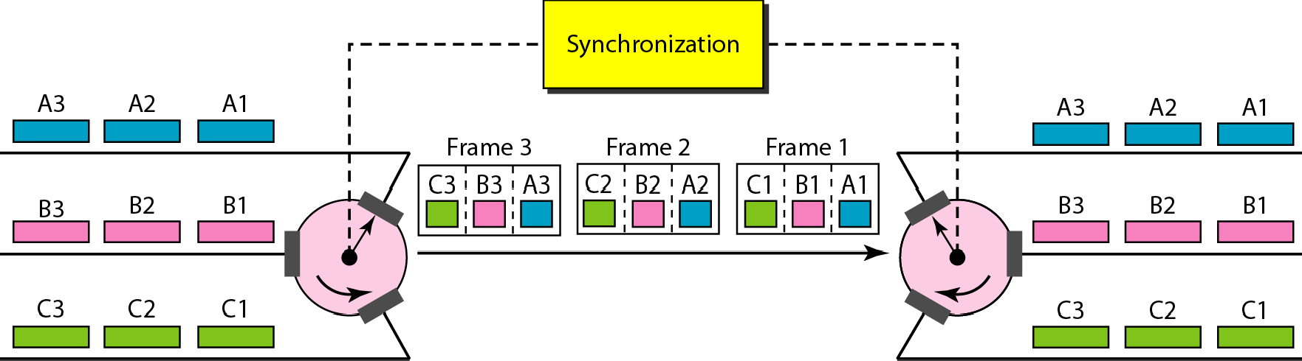
Figure 6.15 Interleaving

Slide 33
Example 6.8
Four channels are multiplexed using TDM. If each channel sends 100 bytes /s and we multiplex 1 byte per channel, show the frame traveling on the link, the size of the frame, the duration of a frame, the frame rate, and the bit rate for the link.
Solution
The multiplexer is shown in Figure 6.16. Each frame carries 1 byte from each channel; the size of each frame, therefore, is 4 bytes, or 32 bits. Because each channel is sending 100 bytes/s and a frame carries 1 byte from each channel, the frame rate must be 100 frames per second. The bit rate is 100 × 32, or 3200 bps.

Slide 34
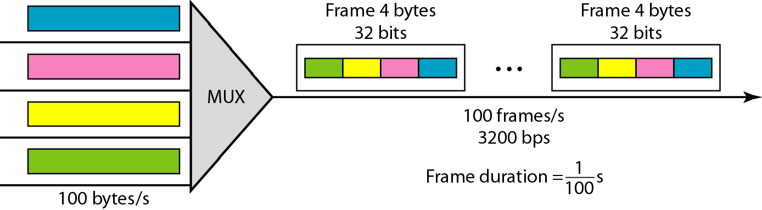
Figure 6.16 Example 6.8

Slide 35
Example 6.9
A multiplexer combines four 100-kbps channels using a time slot of 2 bits. Show the output with four arbitrary inputs. What is the frame rate? What is the frame duration? What is the bit rate? What is the bit duration?
Solution
Figure 6.17 shows the output for four arbitrary inputs. The link carries 50,000 frames per second. The frame duration is therefore 1/50,000 s or 20 μs. The frame rate is 50,000 frames per second, and each frame carries 8 bits; the bit rate is 50,000 × 8 = 400,000 bits or 400 kbps. The bit duration is 1/400,000 s, or 2.5 μs.

Slide 36
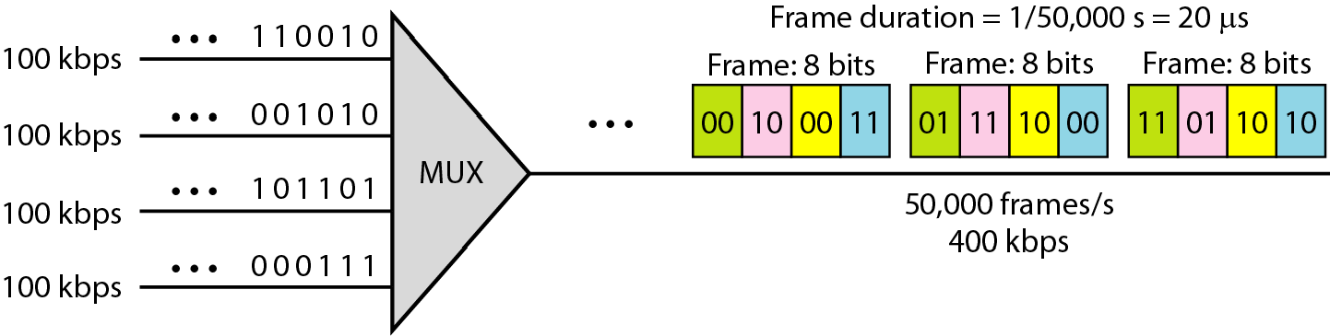
Figure 6.17 Example 6.9

Slide 37
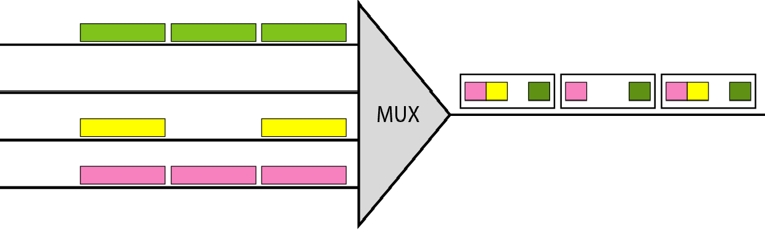
Figure 6.18 Empty slots

Slide 38
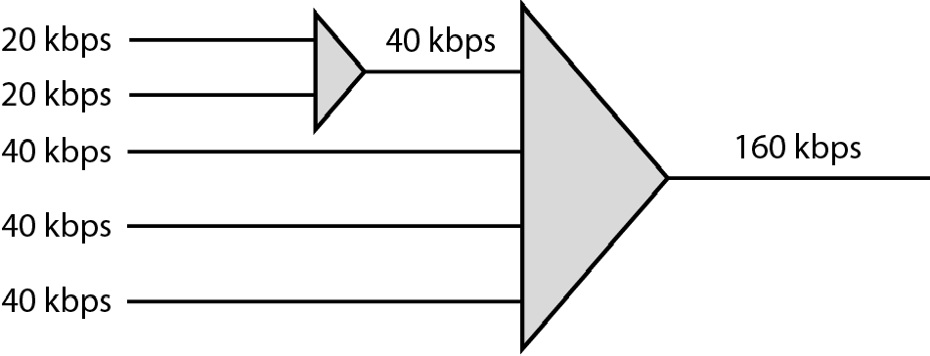
Figure 6.19 Multilevel multiplexing

Slide 39
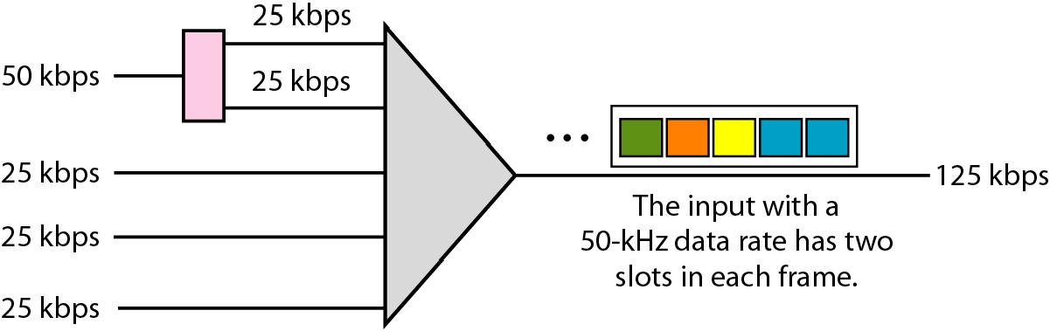
Figure 6.20 Multiple-slot multiplexing

Slide 40
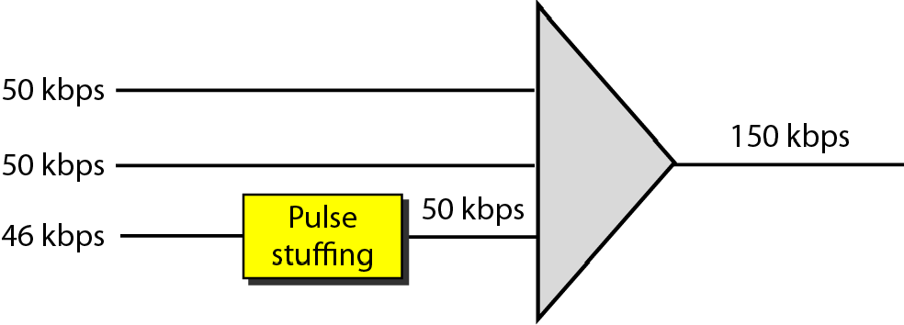
Figure 6.21 Pulse stuffing

Slide 41
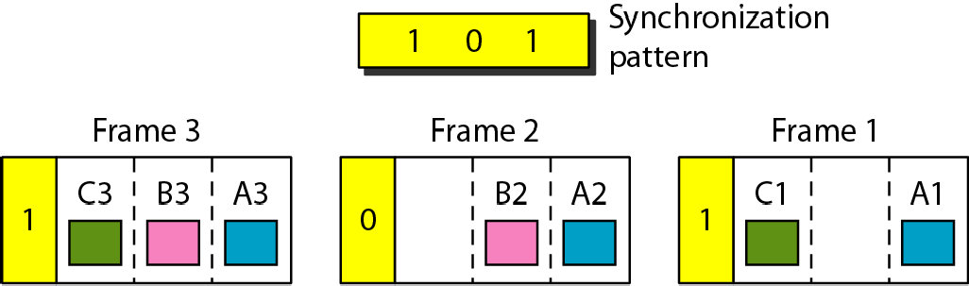
Figure 6.22 Framing bits

Slide 42
Example 6.10
We have four sources, each creating 250 characters per second. If the interleaved unit is a character and 1 synchronizing bit is added to each frame, find (a) the data rate of each source, (b) the duration of each character in each source, (c) the frame rate, (d) the duration of each frame, (e) the number of bits in each frame, and (f) the data rate of the link.
Solution
We can answer the questions as follows:
a. The data rate of each source is 250 × 8 = 2000 bps = 2 kbps.

Slide 43
Example 6.10 (continued)
Each source sends 250 characters per second; therefore, the duration of a character is 1/250 s, or 4 ms.
Each frame has one character from each source, which means the link needs to send 250 frames per second to keep the transmission rate of each source.
The duration of each frame is 1/250 s, or 4 ms. Note that the duration of each frame is the same as the duration of each character coming from each source.
Each frame carries 4 characters and 1 extra synchronizing bit. This means that each frame is 4 × 8 + 1 = 33 bits.

Slide 44
Example 6.11
Two channels, one with a bit rate of 100 kbps and another with a bit rate of 200 kbps, are to be multiplexed How this can be achieved? What is the frame rate? What is the frame duration? What is the bit rate of the link?
Solution
We can allocate one slot to the first channel and two slots to the second channel. Each frame carries 3 bits. The frame rate is 100,000 frames per second because it carries
1 bit from the first channel. The bit rate is 100,000 frames/s × 3 bits per frame, or 300 kbps.

Slide 45
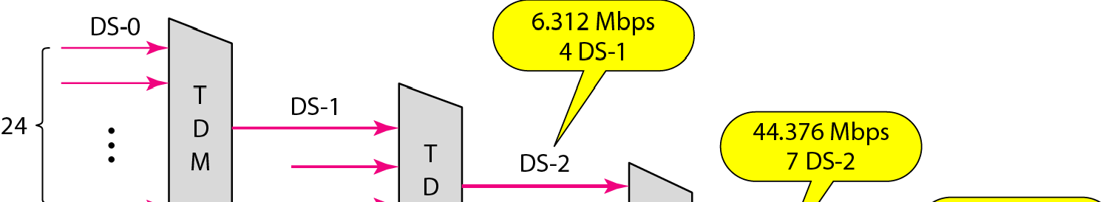
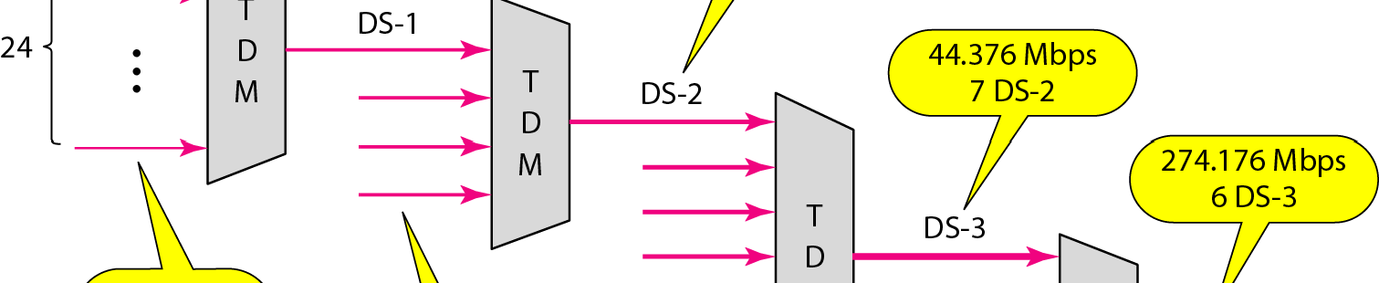
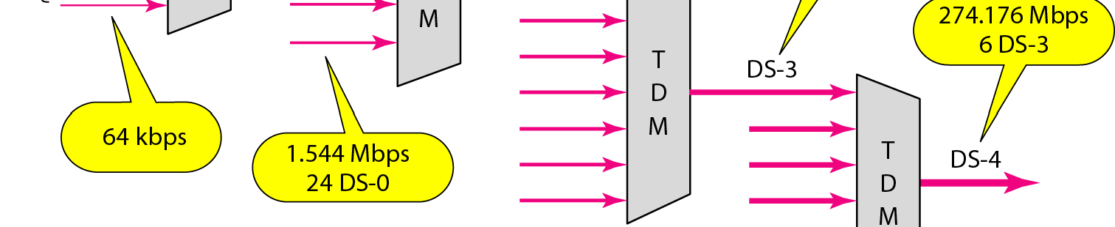
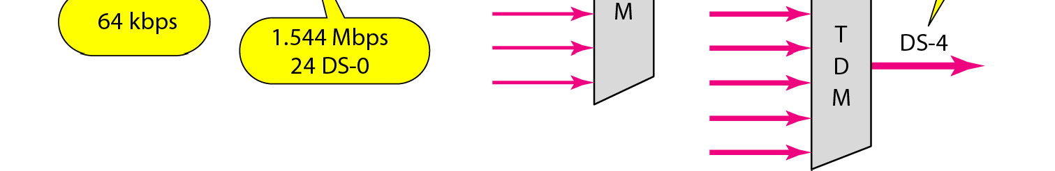
Figure 6.23 Digital hierarchy

Slide 46
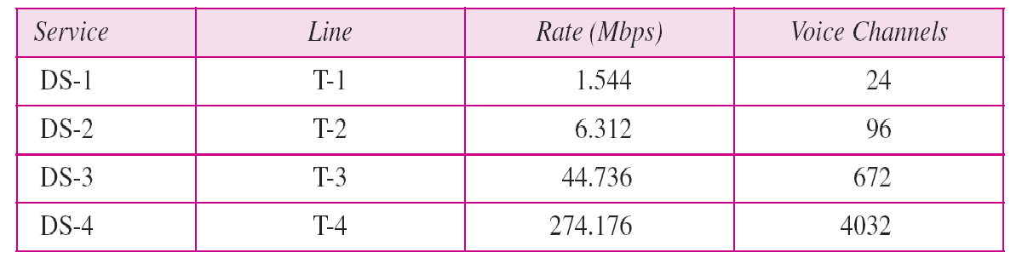
Table 6.1 DS and T line rates

Slide 47
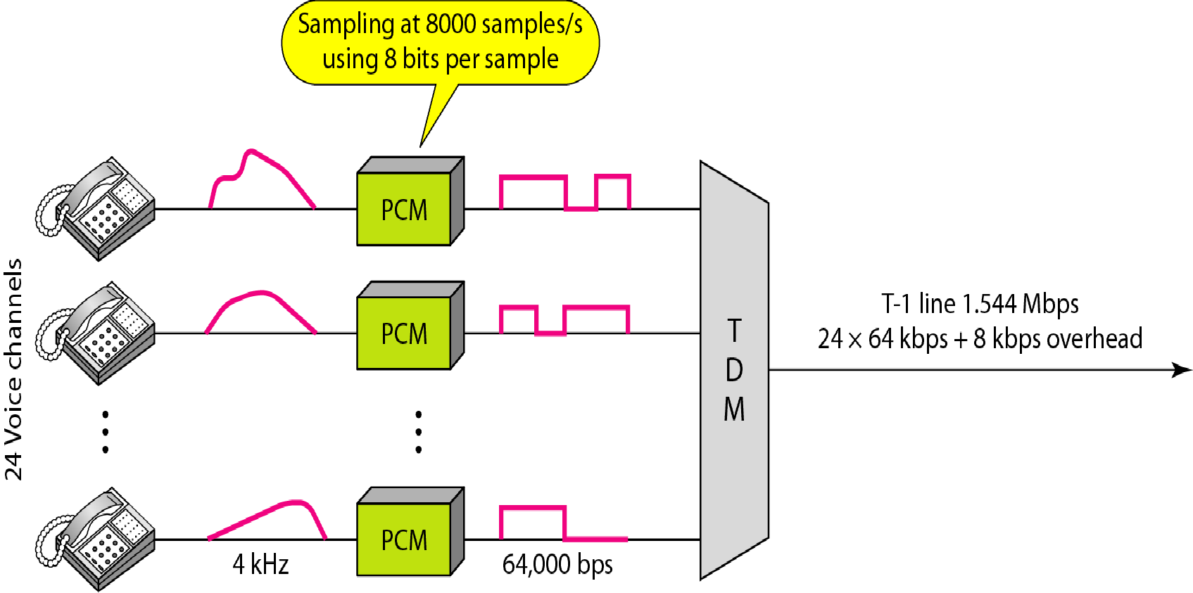
Figure 6.24 T-1 line for multiplexing telephone lines

Slide 48
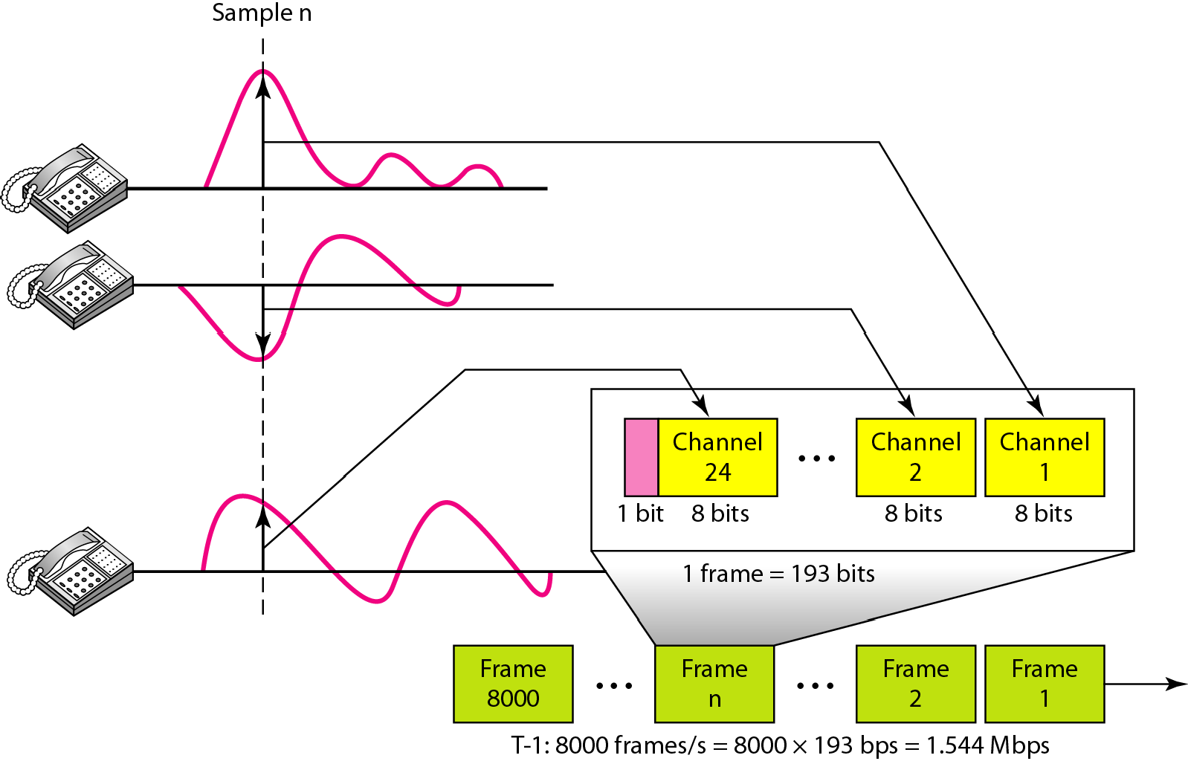
Figure 6.25 T-1 frame structure

Slide 49
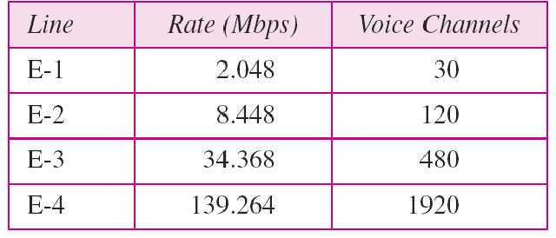
Table 6.2 E line rates

Slide 50
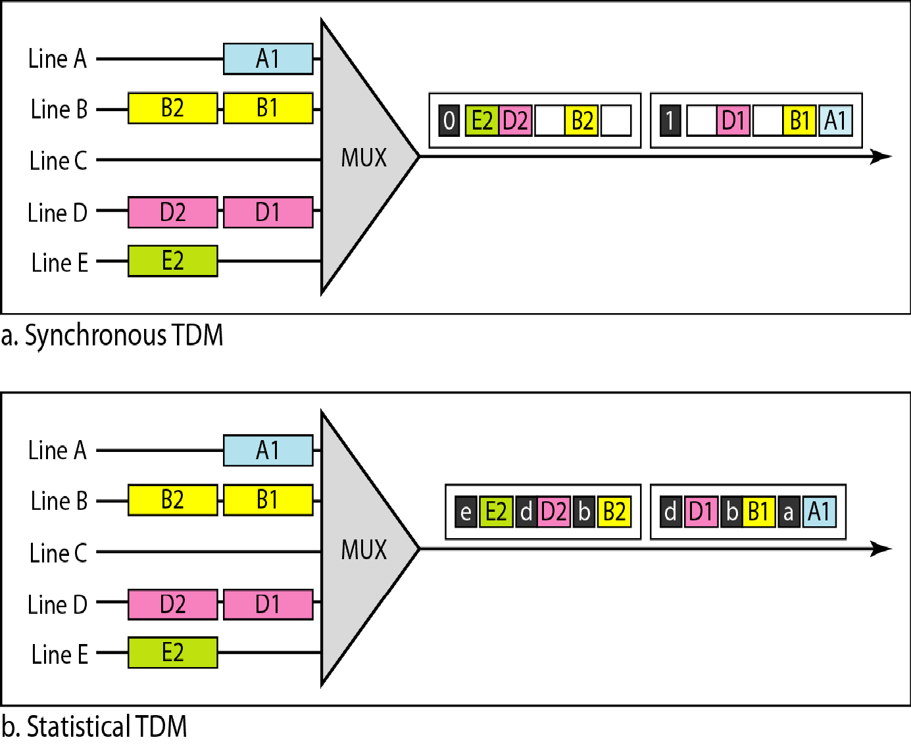
Figure 6.26 TDM slot comparison

Slide 51
6-1 SPREAD SPECTRUM
In spread spectrum (SS), we combine signals from different sources to fit into a larger bandwidth, but our goals are to prevent eavesdropping and jamming. To achieve these goals, spread spectrum techniques add redundancy.
Topics discussed in this section:
Frequency Hopping Spread Spectrum (FHSS)
Direct Sequence Spread Spectrum Synchronous (DSSS)

Slide 52
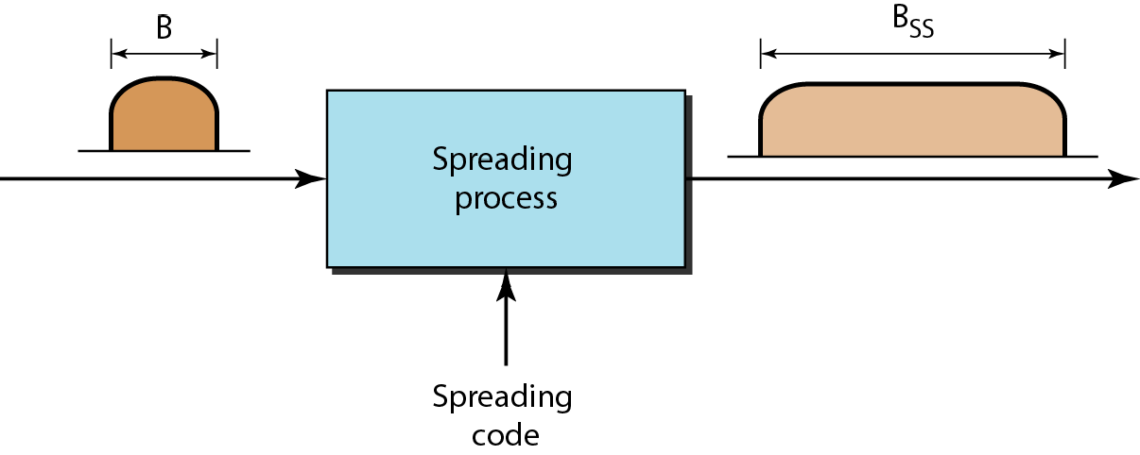
Figure 6.27 Spread spectrum

Slide 53
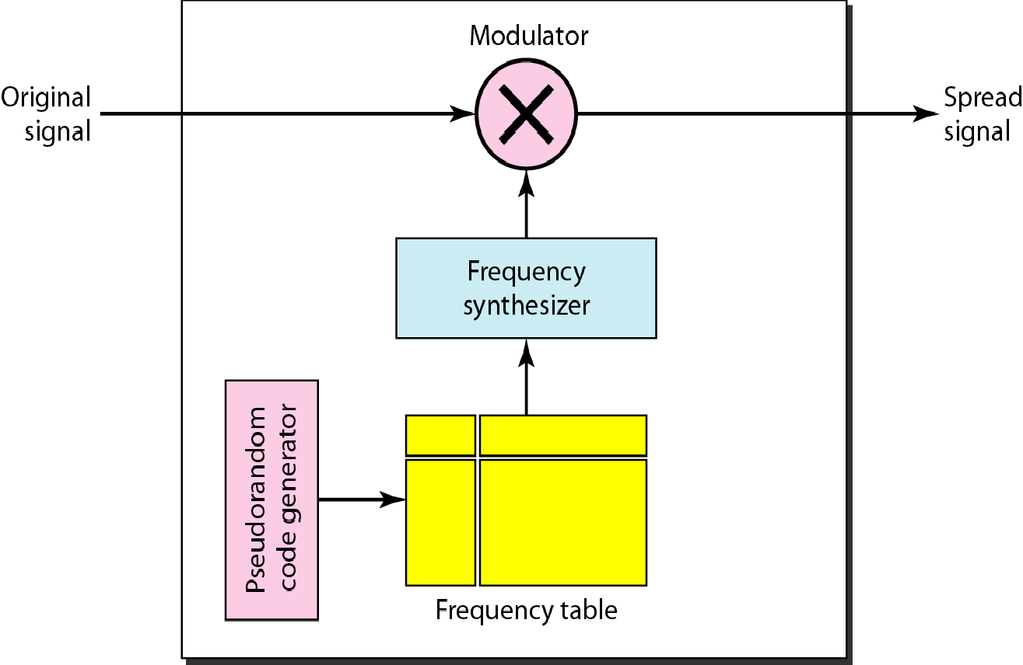
Figure 6.28 Frequency hopping spread spectrum (FHSS)

Slide 54
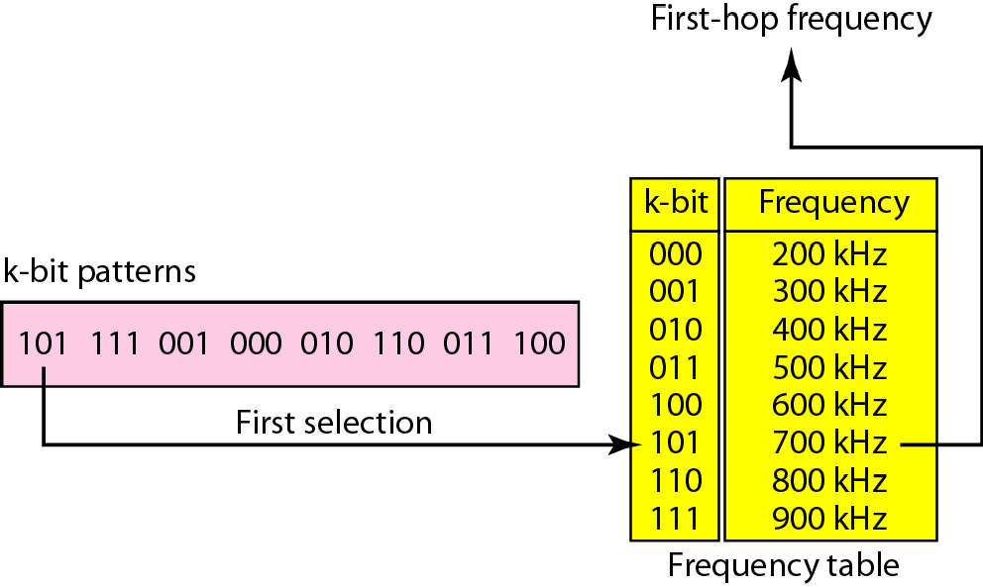
Figure 6.29 Frequency selection in FHSS

Slide 55
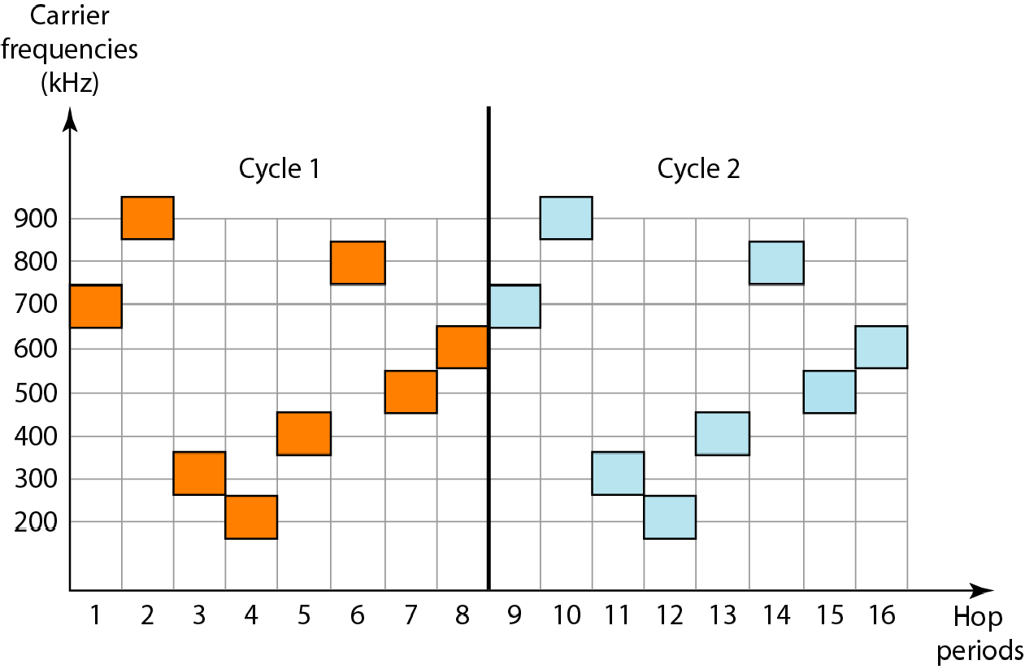
Figure 6.30 FHSS cycles

Slide 56
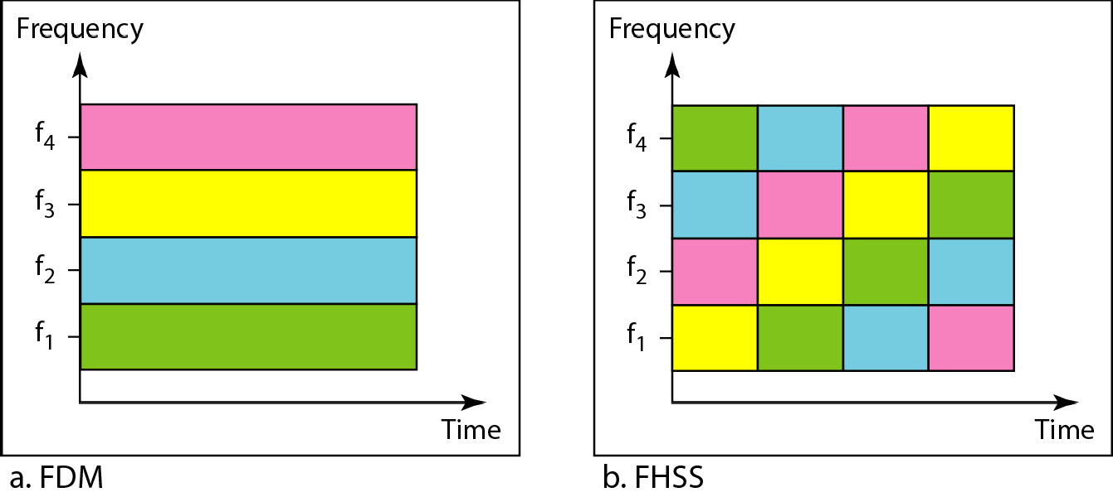
Figure 6.31 Bandwidth sharing

Slide 57
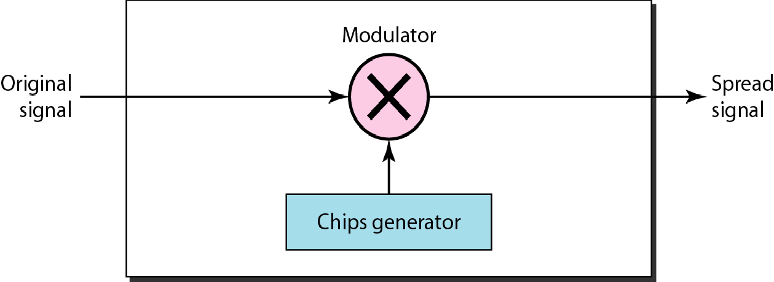
Figure 6.32 DSSS

Slide 58
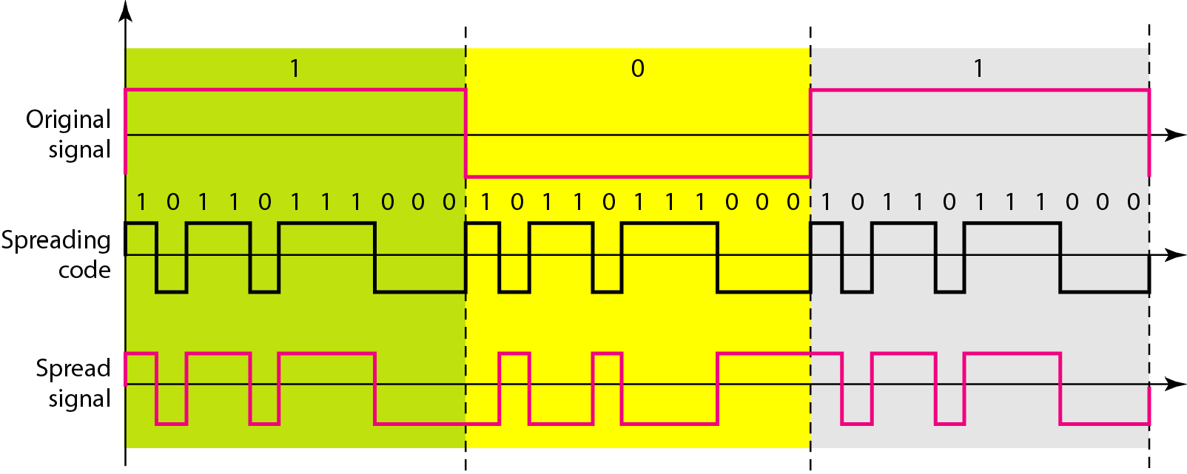
Figure 6.33 DSSS example

